Slide 1
In-Home Supportive
Services (IHSS)
County of Sacramento
Department of Child, Family
and Adult Services (DCFAS)
May 2025

Slide 2
What is IHSS?
In-Home Supportive Services (IHSS)
Medi-Cal based, state and federally funded program for income-eligible aged, blind and disabled adults and children.
Enables individuals to remain safely in their homes and communities, as an alternative to out-of-home institutionalization
Participant Directed
Recipients choose their own care providers
Services include:
Domestic and Related Services
Personal Care Services
Protective Supervision
Paramedical Services

Slide 3
Who does IHSS Serve?
Eligibility Criteria
Aged, blind, and disabled individuals,
both adults and children
Active Medi-Cal
California Resident
Live in Own Home
Completed Health Care Certification
(SOC 873)
Threshold Level of Need

Slide 4
Applications and Referrals
How to Apply
Applications and Referral
To apply call: (916) 874-9471
Monday-Friday (9:00 am – 4:00 pm)
Or complete and submit an application (SOC 295) for In-Home Supportive Services to:
In-Home Supportive Services P.O. Box 269131
Sacramento, CA 95826
Fax: (916) 854-8828
Email: IHSSApplications@saccounty.gov
Referrals
Third party who does not have legal authority
Follow-up regarding need/desire for application required

Slide 5
Program Demographics

Slide 6
Demographics of IHSS
State of California
Total number
Recipients: 839,793
Care Providers: 742,300
Sacramento County
Total number
Recipients: 40,881
Care Providers: 38,665
March 2025

Slide 7
Statewide
Age Demographics of IHSS
Sacramento County
Age Group | Count | Percentage
0 - 17 years (Minors) | 4,740 | 11.6%
18 - 44 years | 6,030 | 14.8%
45 - 64 years | 9,675 | 23.7%
65 - 74 years | 9,187 | 22.5%
75 - 84 years | 7,140 | 17.5%
85+ years | 4,109 | 10.1%
Total | 40,881 | 100%
Age Group | Count | Percentage
0 – 17 years (Minors) | 90,536 | 10.8%
18 – 44 years | 119,688 | 14.3%
45 – 64 years | 162,242 | 19.3%
65 – 74 years | 176,875 | 21.1%
75 – 84 years | 172,080 | 20.5%
85+ years | 118,372 | 14.1%
Total | 839,793 | 100%
March 2025

Slide 8
Cultural and Language Special Skills Social Workers – Sacramento County IHSS
Armenian
Black/African American
Chinese (Cantonese and Mandarin)
Farsi
Hmong
Mien
Punjabi
Russian
Spanish
Vietnamese
*Contracted Interpreter Services are utilized as necessary

Slide 9
Assessment and Service Tasks

Slide 10
IHSS Authorized Services
Domestics | Bowel & Bladder Care
Meal Preparation/ Meal Clean-up | Dressing
Laundry | Bathing, Grooming & Oral Hygiene
Food Shopping & Errands | Accompaniment to Medical Appts
Respiration (Oxygen, Nebulizer, CPAP) | Medication Management
Feeding | Protective Supervision
Ambulation | Paramedical Services
Transfers | Heavy Cleaning
Rubbing Skin / Repositioning

Slide 11
IHSS Needs Assessment
Assessment based on functional ability to perform activities of daily living (ADLs)/instrumental activities of daily living (IADLs)
Functional Index (FI) Ranking:
Ensures:
Similar functional level of need ranked similarly
Same standards used with all recipients
Equal opportunity to experience independence
and safety
Hourly Task Guidelines (HTGs) – Range of hours corresponding with assessed functional ranking
Authorization of service hours based on a monthly basis
Ranking | Level of Required Assistance
Rank 1 | Independent
Rank 2 | Verbal assistance only
Rank 3 | Some human assistance needed
Rank 4 | Substantial human assistance needed
Rank 5 | Total dependent
Rank 6 | Paramedical only

Slide 12
Unauthorized Activities
Services Not Provided:
Include, but not limited to:
Pet care
Salon or barber visits
Transportation to church or community events
Lunch dates
Friendly visiting or socializing
Financial Management

Slide 13
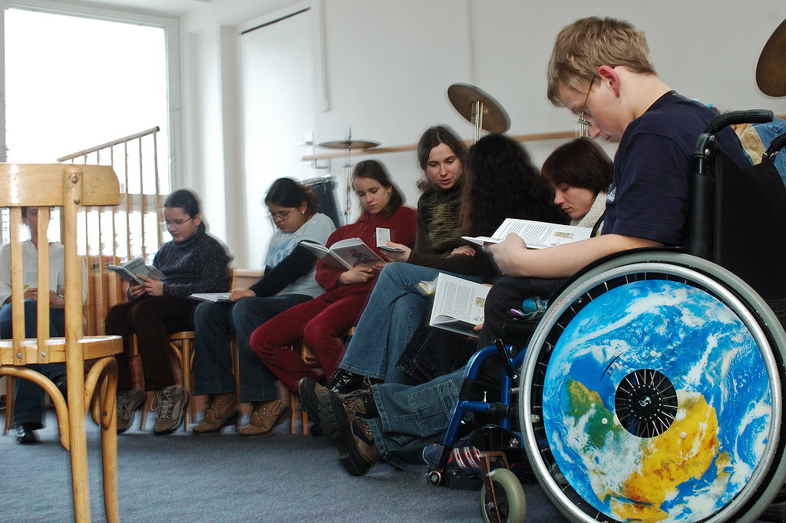
Alternative Resources to IHSS
Alternative resources are which may be available from other agencies or programs to meet the needs of recipients
Services provided are in lieu of IHSS program-funded service
Examples of alternative resources include, but are not limited to:
Adult or child day care centers
Schools
Meals on Wheels (MOW)
Community-based service programs
Senior Centers
Respite centers

Slide 14
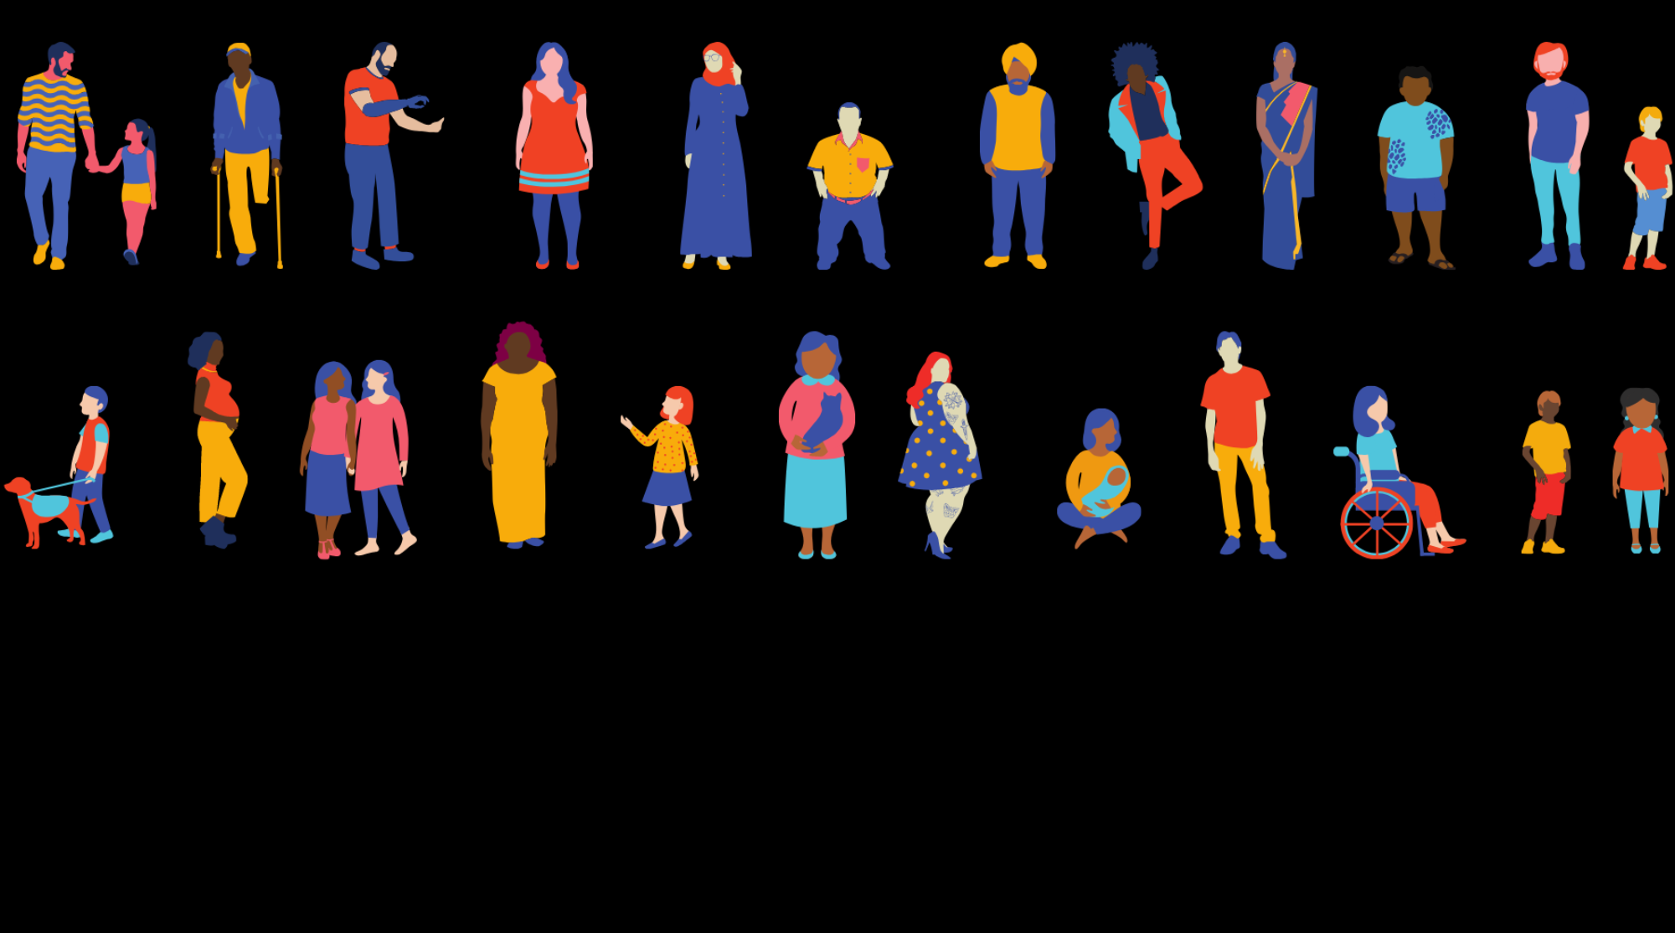
Roles and Responsibilities

Slide 15
Recipient as Employer
Locate, hire, train, supervise and terminate their care provider(s)
Set work schedule for provider(s) and track the number of hours work
Review, approve and/or deny electronic timesheets
Set and maintain boundaries
Recipient Fact Sheets: https://www.cdss.ca.gov/inforesources/ihss/fact-sheets

Slide 16
Care Provider as Employee
Must complete Provider Orientation and Enrollment (SOC 426)
Submit Recipient Designation of Provider (SOC 426A)
Register to use the Electronic Services Portal (ESP)
Electronic submission of IHSS timesheets
Provider Resources: https://www.cdss.ca.gov/inforesources/ihss/ihss-providers/resources

Slide 17
Social Worker as Educator
Ensure recipients understand the application/assessment process
Discuss IHSS program services
Discuss Functional Index (FI) Rankings
Discuss Hourly Task Guidelines (HTGs)
Explain the Notice of Action (NOA)
Advise of appeal rights

Slide 18
State of California Department of Social Services IHSS Resources and Regulations https://www.cdss.ca.gov/
Questions?

