Slide 1
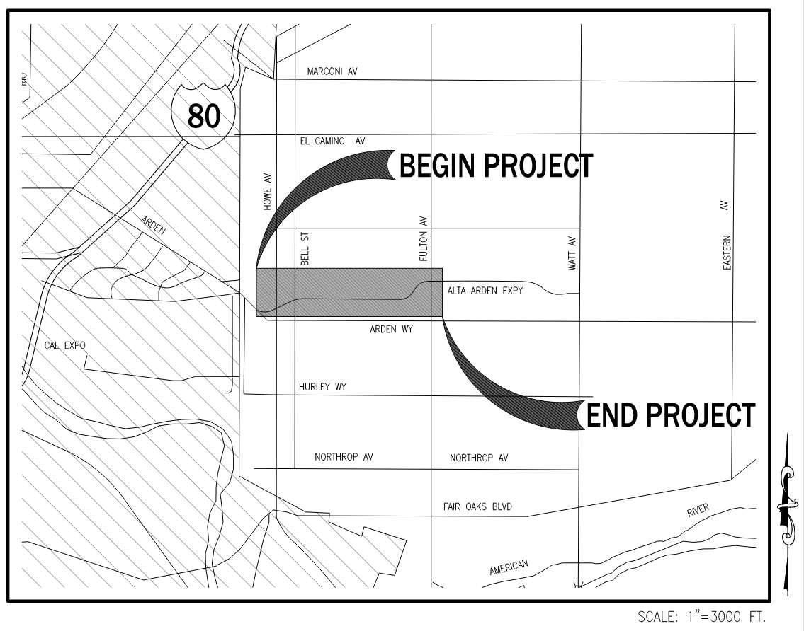

Alta Arden Expressway Phase 1 Project
Project Limits Map – Alta Arden Expressway – Limits Between Howe Avenue and Fulton Avenue – Approximately 1 mile

Slide 2
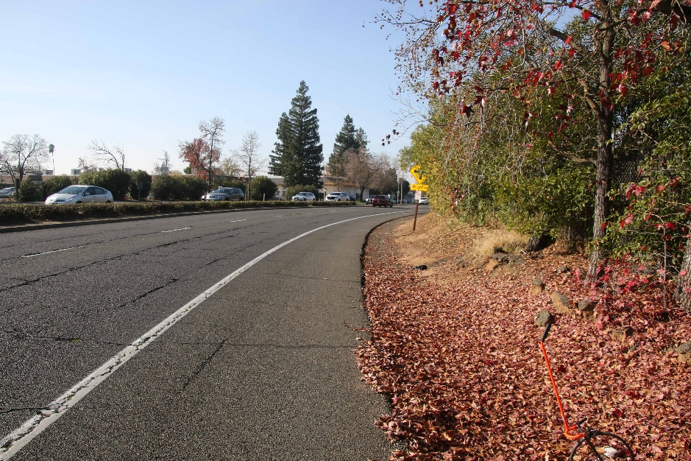
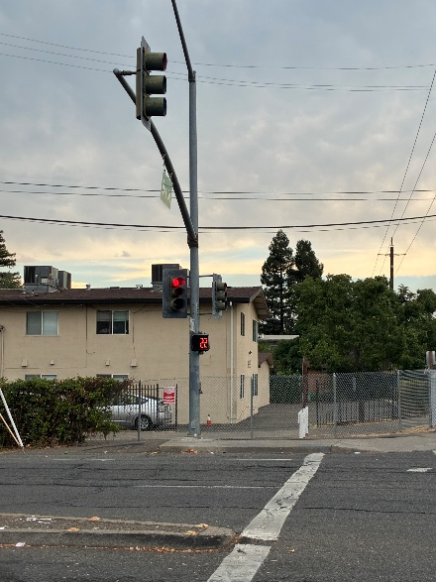
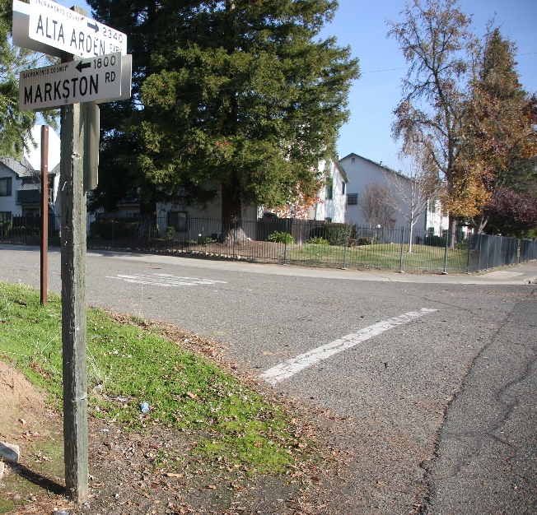
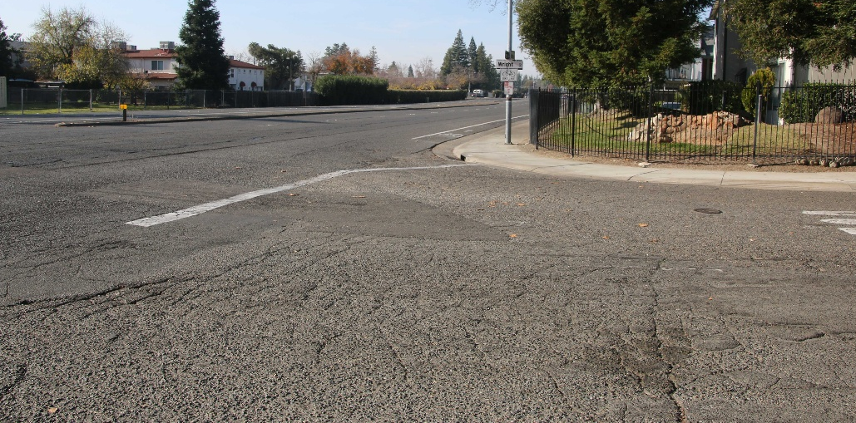
Alta Arden Expressway – Photos of Current Conditions
Photo 1
No Sidewalk
Photo 3
Photo 4
Substandard or Missing Curb Ramps
Sub Standard Traffic Signals
Photo 2
Failing Pavement
Notes:
Photo 1 taken looking Eastbound on Alta Arden, between Fulton Avenue and Wright Street
Photo 2 taken looking Westbound on Alta Arden at Wright Street intersection
Photo 3 taken at Bell Street intersection, looking South
Photo 4 taken at Alta Arden and Markston intersection, looking Northeast

Slide 3
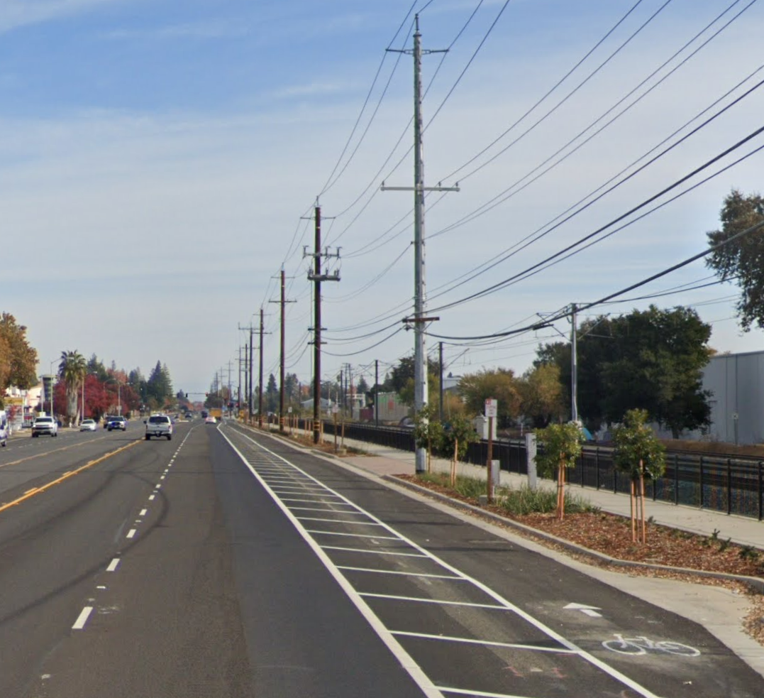
Alta Arden Project Overview
The Alta Arden Expressway Phase 1 Project will add new sidewalks providing pedestrian connectivity between existing sections of sidewalk, Class II bike lanes with striped buffers, accessible curb ramps, and upgraded signals to improve mobility and safety for all corridor users. Concrete medians will be added at Markston Road and Wright Street to improve safety at these intersections. Pavement rehabilitation and resurfacing is also included.
Key Objectives:
Improve pedestrian safety and mobility with the addition of curb, gutter and sidewalk
Enhance interconnectivity and reduce conflict between pedestrians, motorists and cyclists through upgraded traffic signals and other intersection improvements.
Promote active transportation with the neighborhood and contribute to the vision and goals of the West Arden-Arcade Environmental Justice Community
Notes:
Project will enhance safety and mobility for pedestrians and cyclists, including the addition of class II bike lanes on both sides of Alta Arden

Slide 4
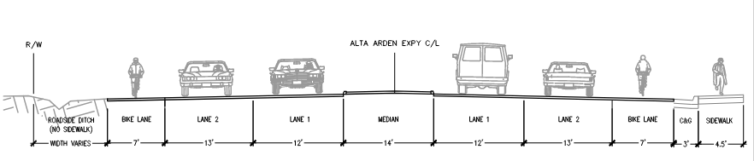
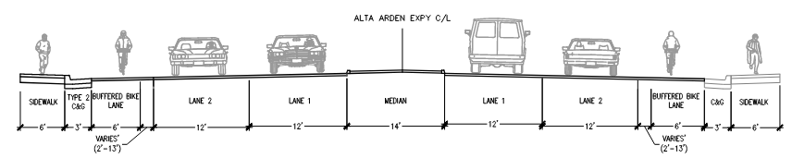
Alta Arden Expressway - Roadway Cross Sections
Existing
Proposed
Westbound
Eastbound

Slide 5
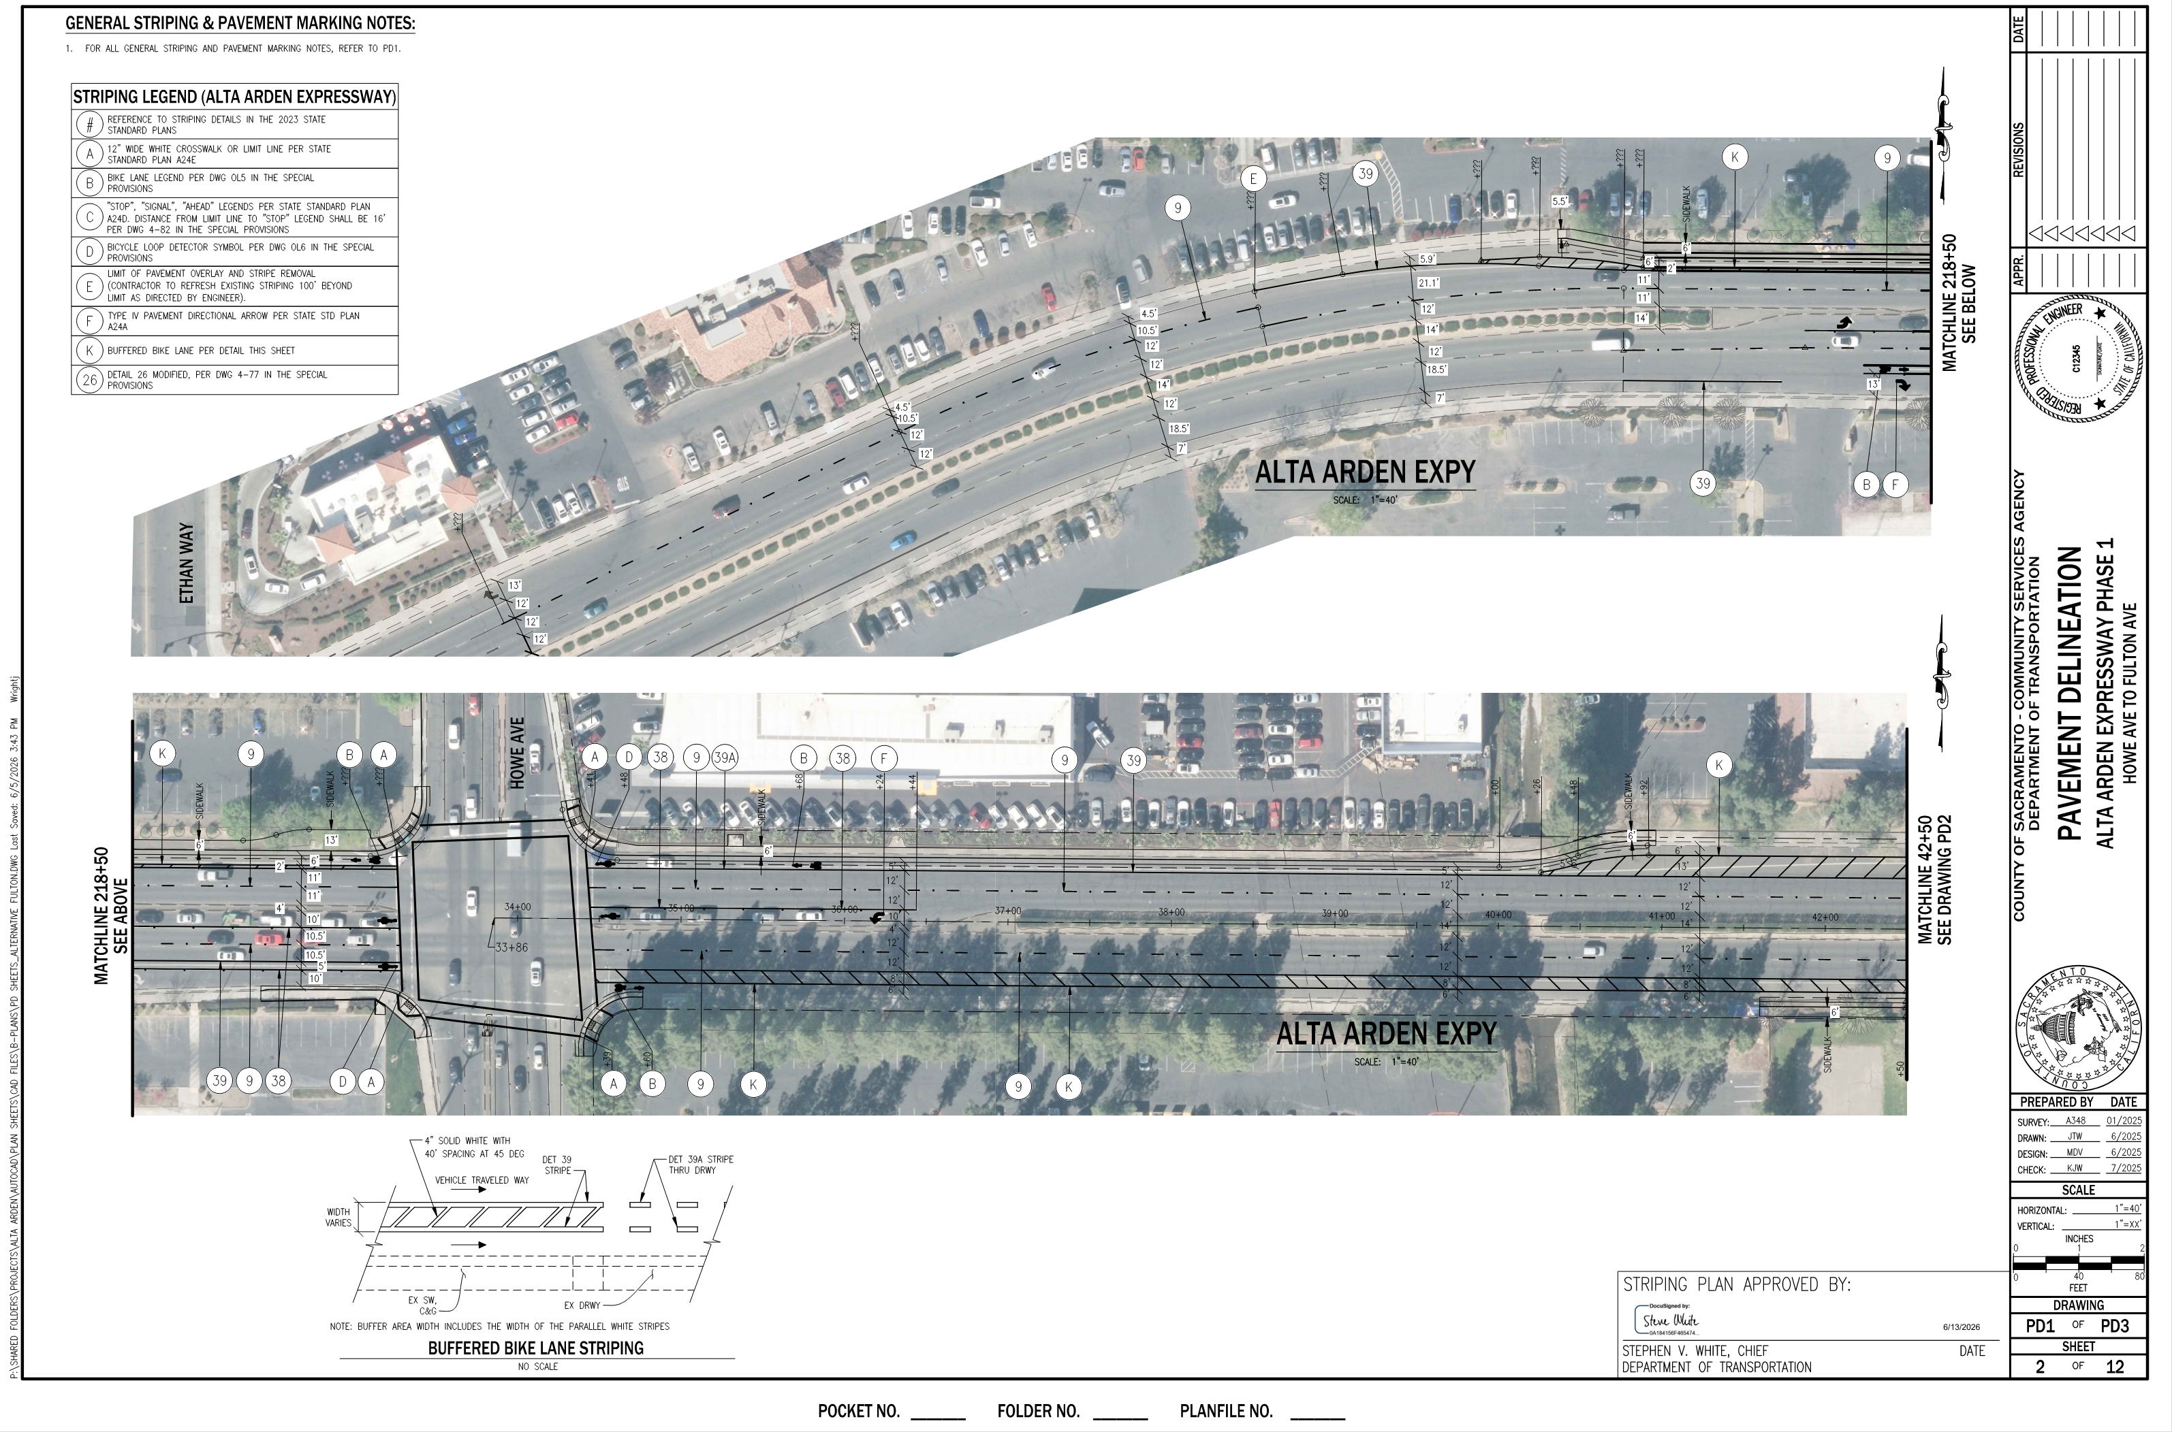
Alta Arden Expressway – Striping Plan

Slide 6
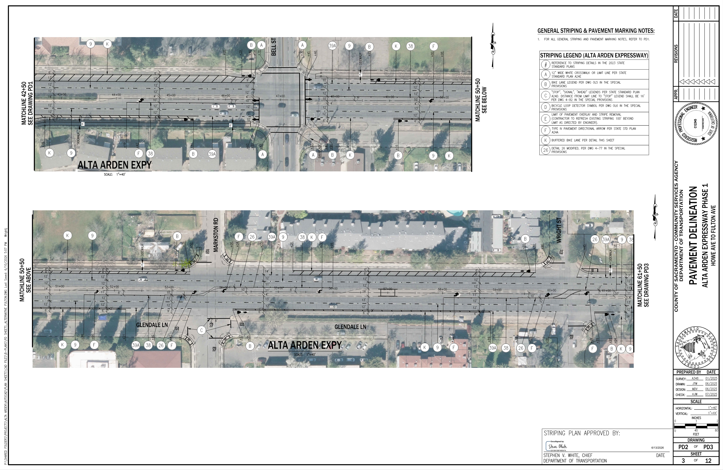
Alta Arden Expressway – Striping Plan

Slide 7
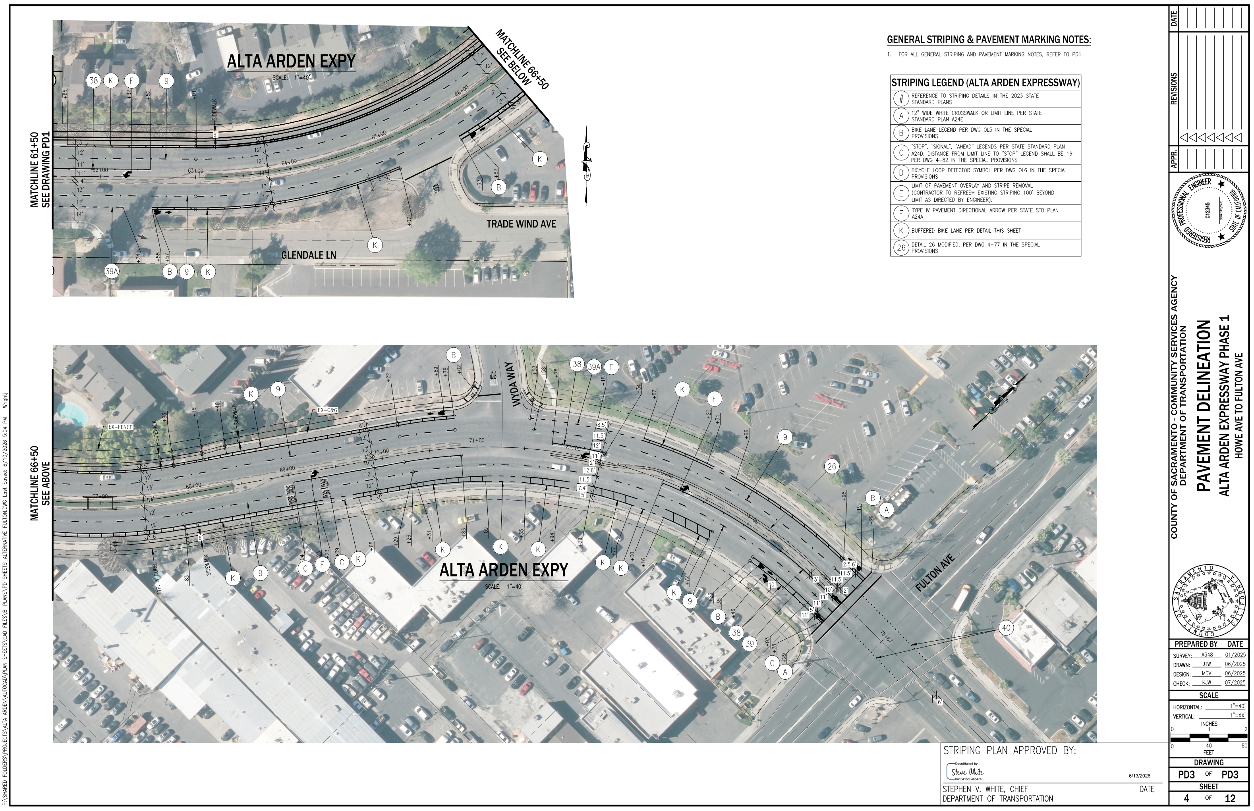
Alta Arden Expressway – Striping Plan

Slide 8
Alta Arden Expressway – Funding and Schedule
Funding Sources
  Federal RSTP
  State STIP
Timeline
  Environmental Clearance – August 2026 (completed)
  Begin Right of Way Acquisitions – October 2026
  Project at BOS for Approval – November 2027
  Bidding – December 2027
  Award – January 2028
  Construction – Spring 2028

